Slide 1
Mindset
A course to develop a Winning Attitude!!

Slide 2
Why do you feel this course would work for our students?
Students need to know they have the ability to learn.
How to make positive and successful changes in their lives.
That you can learn new skills and knowledge.
That Intelligence & Talent can be developed and improved

Slide 3
Why do you feel this course would work for our students?
Mindset teaches that you can Change through effort
Focuses on the level of effort
Teaches you to believe in continued growth
Teaches persistence in the face of setbacks

Slide 4
Why do you feel this course would work for our students?
Mindset teaches self-efficacy
The belief that you can succeed
That goals are attainable
That goals can be envisioned

Slide 5
Why do you feel this course would work for our students?
Mindset creates a Sense of Belonging
Promotes positive relationships with the learning community (Students & Instructors)
Creates a connection to Social Rewards
Communications, Collaboration, & Cooperation
Belonging equals Engagement that drives their desire to learn

Slide 6
Why do you feel this course would work for our students?
Mindset develops Relevance
Work has value and purpose
They value the skills and knowledge they are attaining
They find work relevant and interesting

Slide 7
How does this course meet the needs of learners at different academic levels?
All of the benefits from Mindset are not grade or intelligence dependent
Mindset helps develop the psychological skills and attitude to succeed at any level
The course can be self-paced

Slide 8
How does this course meet the needs of learners at different academic levels?
The course is presented using a multi-modal learning approach
Visual
Aural
Read & Write
Kinesthetic

Slide 9
How does this course meet the needs of learners at different academic levels?
The course has “How to study tips”
Researching
Long–term memory development
Repetition, Mnemonics, Flash Cards
Time management
Stress Management
Physiological Needs

Slide 10
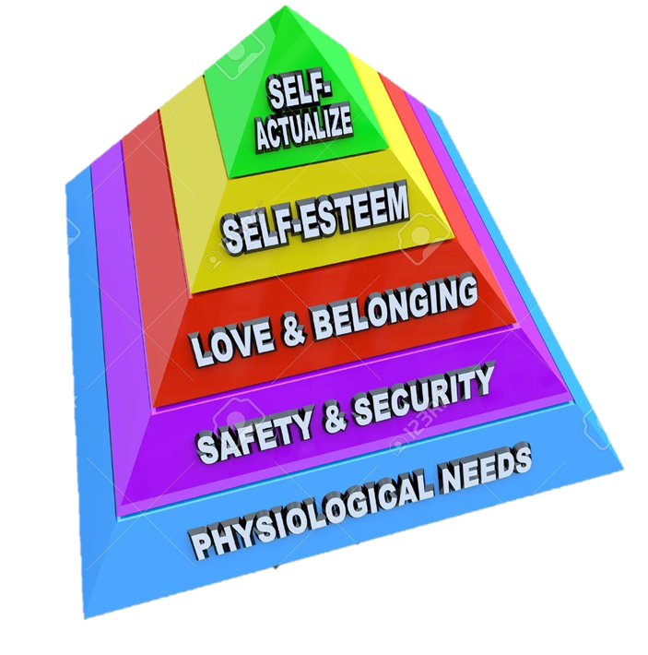
To what standards is this course aligned?
Maslow’s Hierarchy of Needs

Slide 11
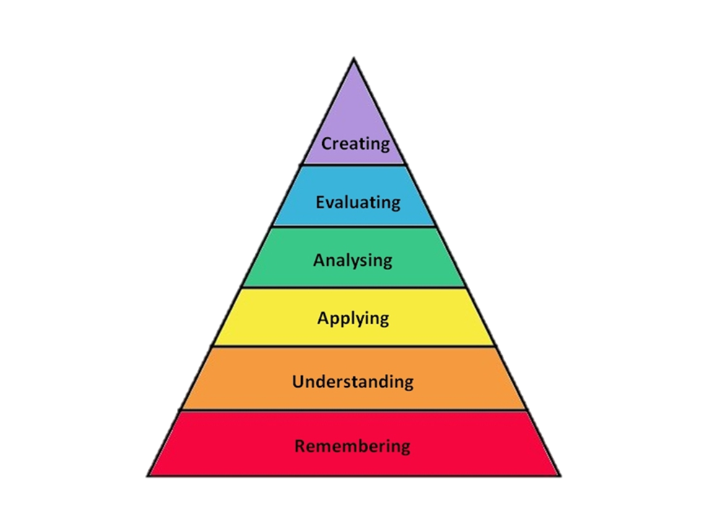
To what standards is this course aligned?
Bloom’s Taxonomy

Slide 12
To what standards is this course aligned?
Brainology

Slide 13
Describe the development process for this course
Read the book
Group discussion
Faculty & Administration
Online training
Brainstorm ideas for assignments
Develop the Rubrics

Slide 14
Describe the development process for this course
Online development
Assigned readings
Assigned Discussion Forum Questions
PPT/Video with Narration & Questions (Camtasia)
Adobe Captivate exercises
Drag & Drop
Pop-up Quizzes
Interactive Hotspots
Adobe Connect
Lecture & Discussion Presentation
Outside Links
TED Talks
Mindset website
Interesting articles

Slide 15
Instructor workshop
To reinforce Mindset in their other classes
Periodically all courses would focus on the same Mindset attribute
Develop Assignments and class exercises that reflect Mindset

Slide 16
Sample Assignments & Exercises
Read pages 1-17 and journal the questions below:
1. Describe a situation where a fixed mindset kept you from getting something you really wanted.
2. Think of someone you know who has a growth mindset. Give an example that showed you they have a growth mindset?
3. In what ways would you like to grow or stretch yourself that will help you reach your career goal? What do you have to do to accomplish this?

Slide 17
Sample Assignments & Exercises
Read pages 18-19, 170-193
1. Looking at your relationship with your partner (if you have one), describe the Fixed Mindset components and the Growth Mindset components of the relationship. Now, describe how you would like your relationship to evolve into a predominately Growth Mindset relationship?

Slide 18
Sample Assignments & Exercises
Read pages 173-192 and journal the following:
1. Recall a time when you didn’t do as good as you would have liked on a task or skill and then gave up.
Why did you give up?
What would you have gained if you didn’t give up, but kept trying?
Do you wish you wouldn’t have given up now that you’ve read Mindset? What could you have done differently?

